Slide 1
Expensive words

Slide 2
Load in art with prices v2
Only keep rows with price_name and summary not null
Resulting dataset is 4702 rows
Define clean_text function for initial cleaning
Apply to name_english, price_name, summary, artist_name
Split artist_name by space to get last name
Keep rows if last name of artist is present in summary
Resulting dataset is 374 rows

Slide 3
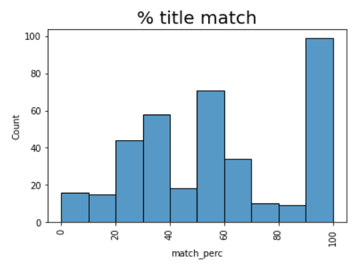
Define count_match_words function and apply to (name_english, price_name) get match_perc
% of total words in name_english present in price_name
Now clean summaries further to get rid of artists names from price analysis
Because these usually end up fragmented in the expensive token selection

Slide 4
Filter out only artworks with a match percentage greater than or equal to 40%
Resulting dataset is 241 rows
Check for duplicates, there are none. Keep all.

Slide 5
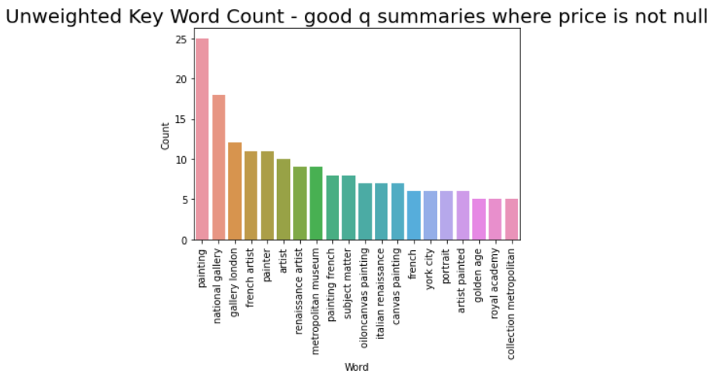
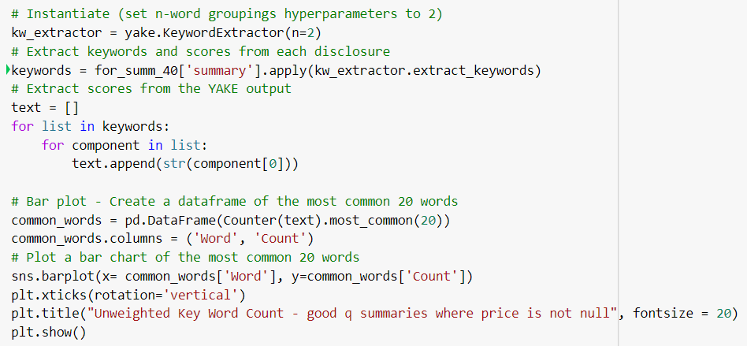
For all summaries where prices are present @ match_perc >= 40%:

Slide 6
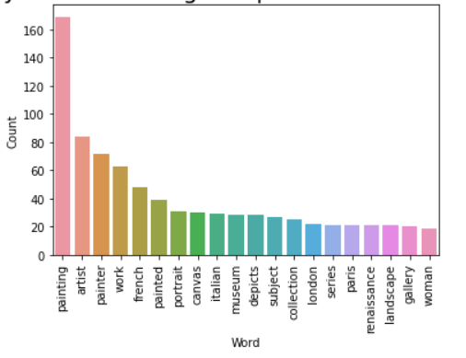
Yake keyword extractor
n = 1

Slide 7
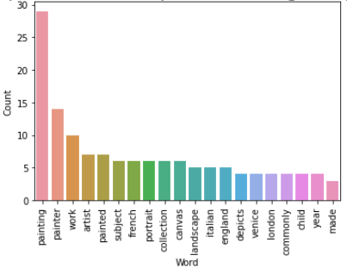
Find percentile of price within total dataset of artworks with prices, after filtering out unmatched (<40% match_perc) (3611 prices)
Find percentile of price within clean summary dataset
Select top 10% of paintings with highest price (situated within total price dataset)
Resulting 38 paintings for_summ_40_exp
Yake keyword extractor with n = 1 for 38 most expensive paintings

Slide 8
Calculate w_price:
Count of text occurrences * (1- weight) * (price)
Where weight is lower == more important keyword from YAKE

Slide 9
Get the distribution of words in the complete (good) summary dataset

